Slide 1
Custom Bakery Order System
Group 7
•
•
•
Member 1 (Sadia Mahmud 19101320): Intro, Feasibility Analysis, Activity Diagram, Sequence Diagram
Member 2 (Tarannaum Jahan Sultan 19101348): USE Case Diagram, State Machine Diagram, DFD(Level 0 & Level 1), Summary

Slide 2

•
•
Planning
Why build the system?
Analysis
Who, what, when, where will the system be?
Design
How will the system work?
Analysis of current system: What are the current drawbacks, restrictions or limitations
Analysis of Proposed System: Competitive Advantages, unique features, nobility, diversity, new dimensions or creative approach etc

Slide 3

Placing Orders Functional Requirement:
FR2.1: The system will be a user-friendly interface for users to place orders in advance.
FR2.2: The system will be organized according to different categories of bakery items to enable users to browse items.
FR2.3: The system will allow users to add/delete items from the cart.
FR2.4: The system will allow users to order customizations such as- Design, flavors, sizes, weights, toppings, quantities.
FR2.5: The system will allow users to view their order status.
Non Functional Requirement:
NFR2.1: The system will maintain the previous order history of users.
Home Bakers Collaboration Functional Requirement:
FR3.1: The system will enable enthusiastic home bakers to apply for serving freshly home-baked products by passing the hiring interviews and necessary requirements.
Non Functional Requirement:
NFR3.1: The system will generate a big platform for all the home bakers for serving numerous personalized bakery items.
NFR 3.2: The system will ensure to make them familiar with the functionality.
Receiving Orders Functional Requirement:
FR4.1: The system will allow sellers to post product details as in pictures, prices, options and special offers.
FR4.2: The system will enable bakers to add/delete their products.
FR4.3: The system can allow bakers to show time to prepare the customized bakery items.
Non Functional Requirement:
NFR4.1: The system will ensure standard resolution of the bakery products.

Slide 4
Update Information:
FR7.1: The system will enable the admin to update information.
FR7.2: The system will allow the admin to view the list of orders and update them if necessary.
Non Functional Requirement:
NFR 7.1: Users will not be able to view other users information or profile. Only admins can view and update them.
Delivery Service:
FR8.1: The system will notify nearby delivery men for fast delivery.
FR8.2: The system should enable route direction for ensuring the delivery service
Non Functional Requirement:
NFR 8.1: The system will generate a map to enable the delivery man to view the exact location of the customer.
Non-Functional:
1. Operational :
1.1: The system should be able to run on android, web, ios.
1.2: The system should be able to integrate with the existing order management system.
2. Performance :
2.1: The system should be able to maintain coding conventions and follow up documents.
2.2: The system should be able to handle large numbers of users simultaneously.
2.3: The system should be user-friendly for users to place orders as well as for sellers to sell their bakery items.
2.4: The system should operate 90% of responses within a few seconds.
2.5: The system should be available 24/7.
3. Security :
3.1: The system should ensure complete security to user’s confidential data.
3.2: The system should enable admins to monitor sellers,buyers and delivery man.
4. Cultural and Political :
4.1: The system should protect all personal information by the Data Protection Act.
4.2: The system would support both English and Bangla language for users as well as sellers.
4.3: The system should present a digital legal agreement form to ensure transparency and authenticity.

Slide 5
Use Case Diagram:
•In this Custom Bakery Order System, there are 4 types of actors involved. The primary actors who will perform the main system are the customers, bakers/sellers. The secondary actors are the delivery man and admin. In order to use the system functionalities every user needs to be logged into the system.
•After login confirmation, if the customer wants to view bakery items he can search/ select/ select form recommendation for his desired items. A customer can place customize order as there will be options to select from the categorized bakery items. They can customize their orders by flavors,shapes, ingredients, sizes, toppings, types etc and complete payment.
•The bakers will categorize bakery items based on types, ingredients, toppings,shapes,sizes etc. Moreover, Bakers can sell bakery product if only they get selling permit confirmed by admin.
•The admin will perform the administrative functions & the delivery man will deal with the delivery functions.

Slide 6
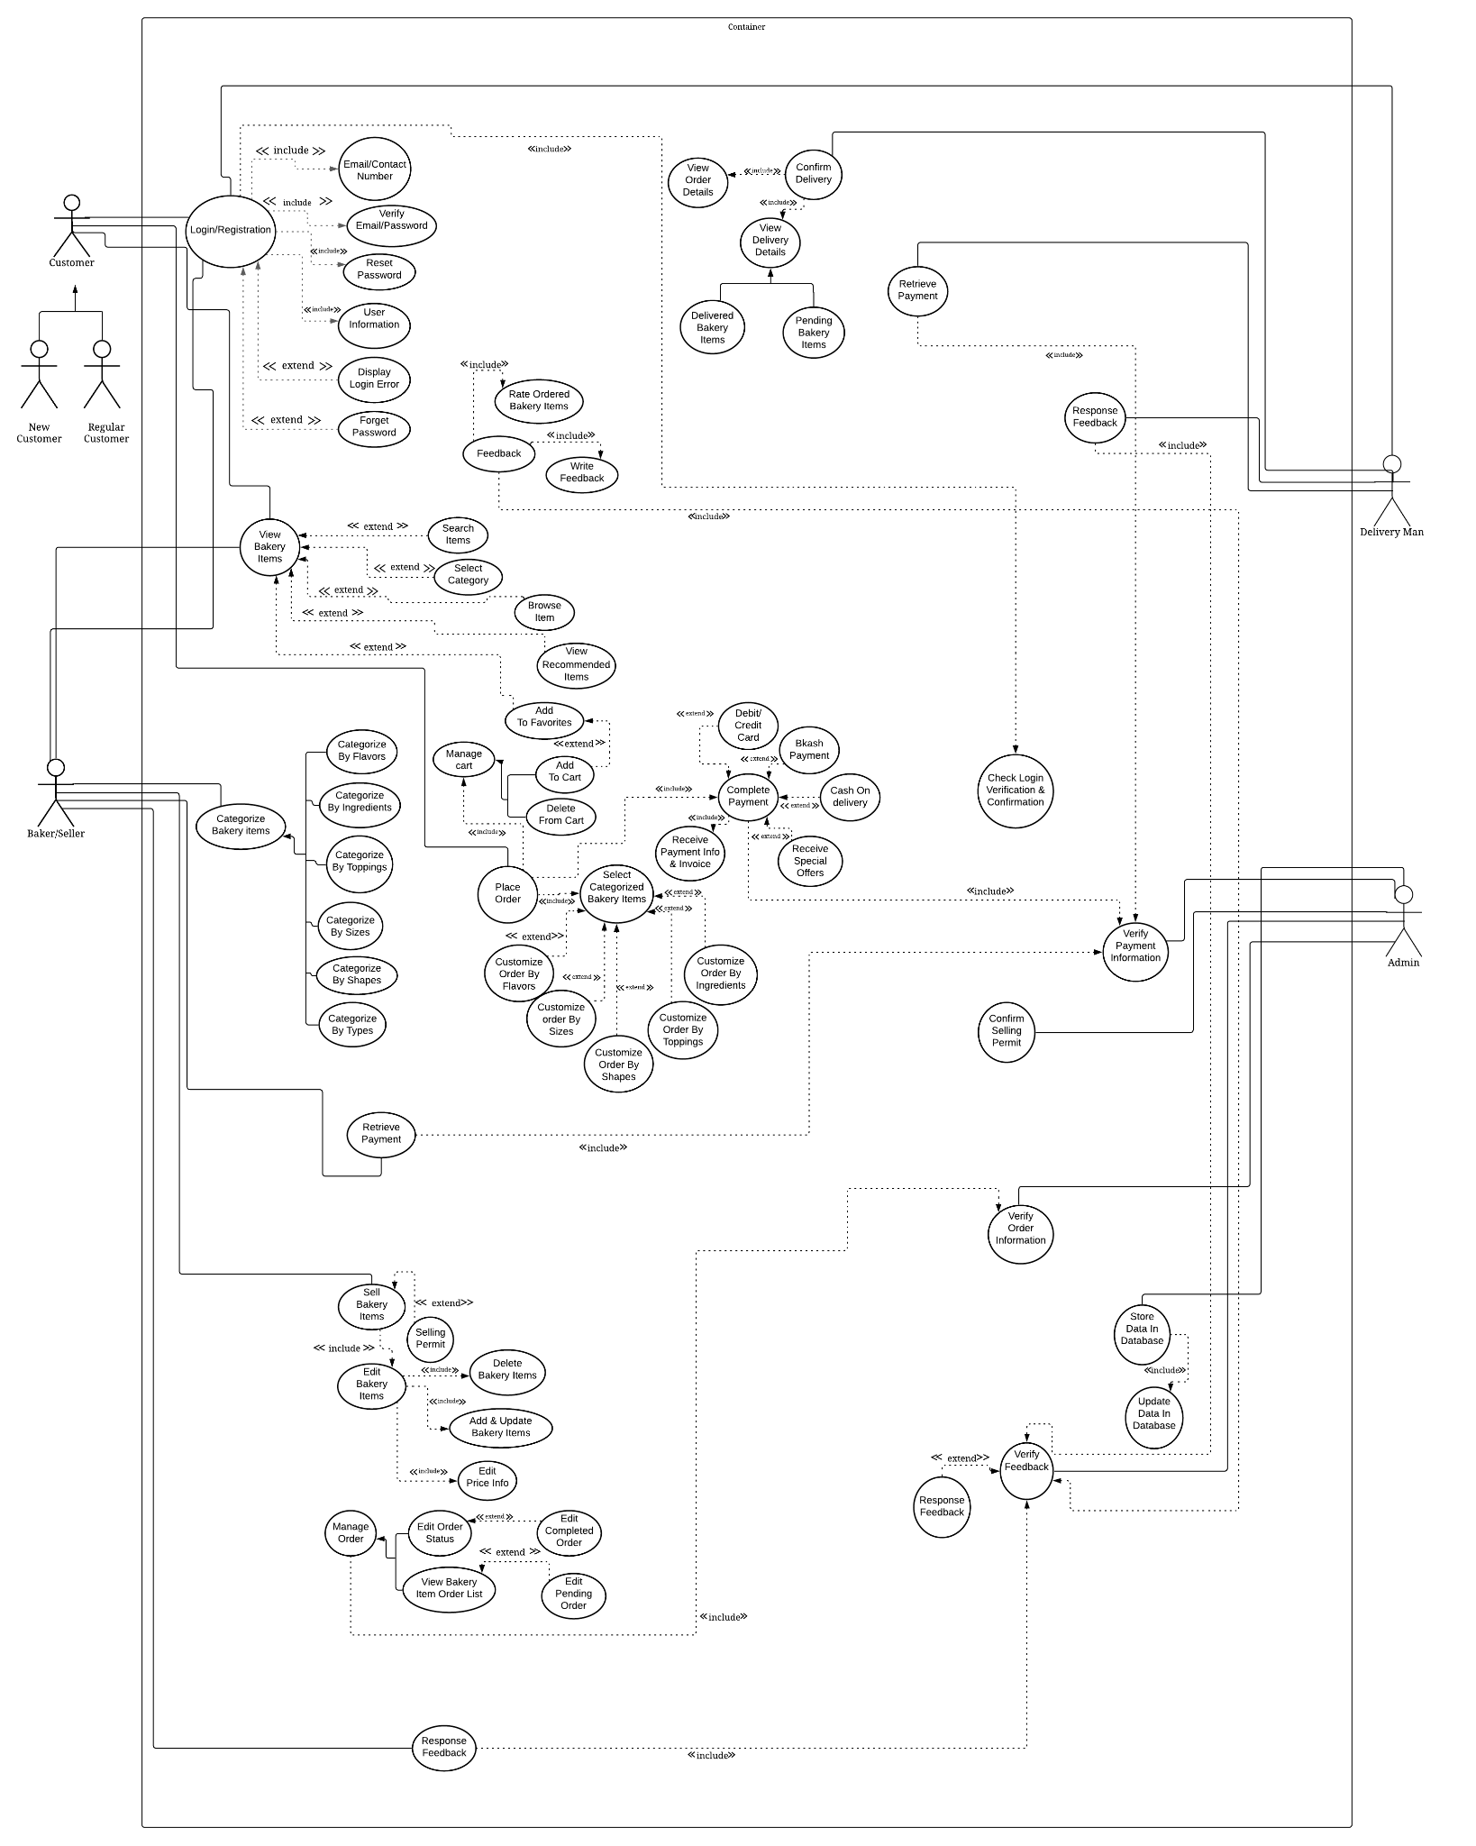
USE Case Diagram
https://lucid.app/lucidchart/invitations/accept/inv_63582267-a0ad-4062-8044-c51115128212?viewport_loc=284%2C105%2C2731%2C1323%2C0_0

Slide 7
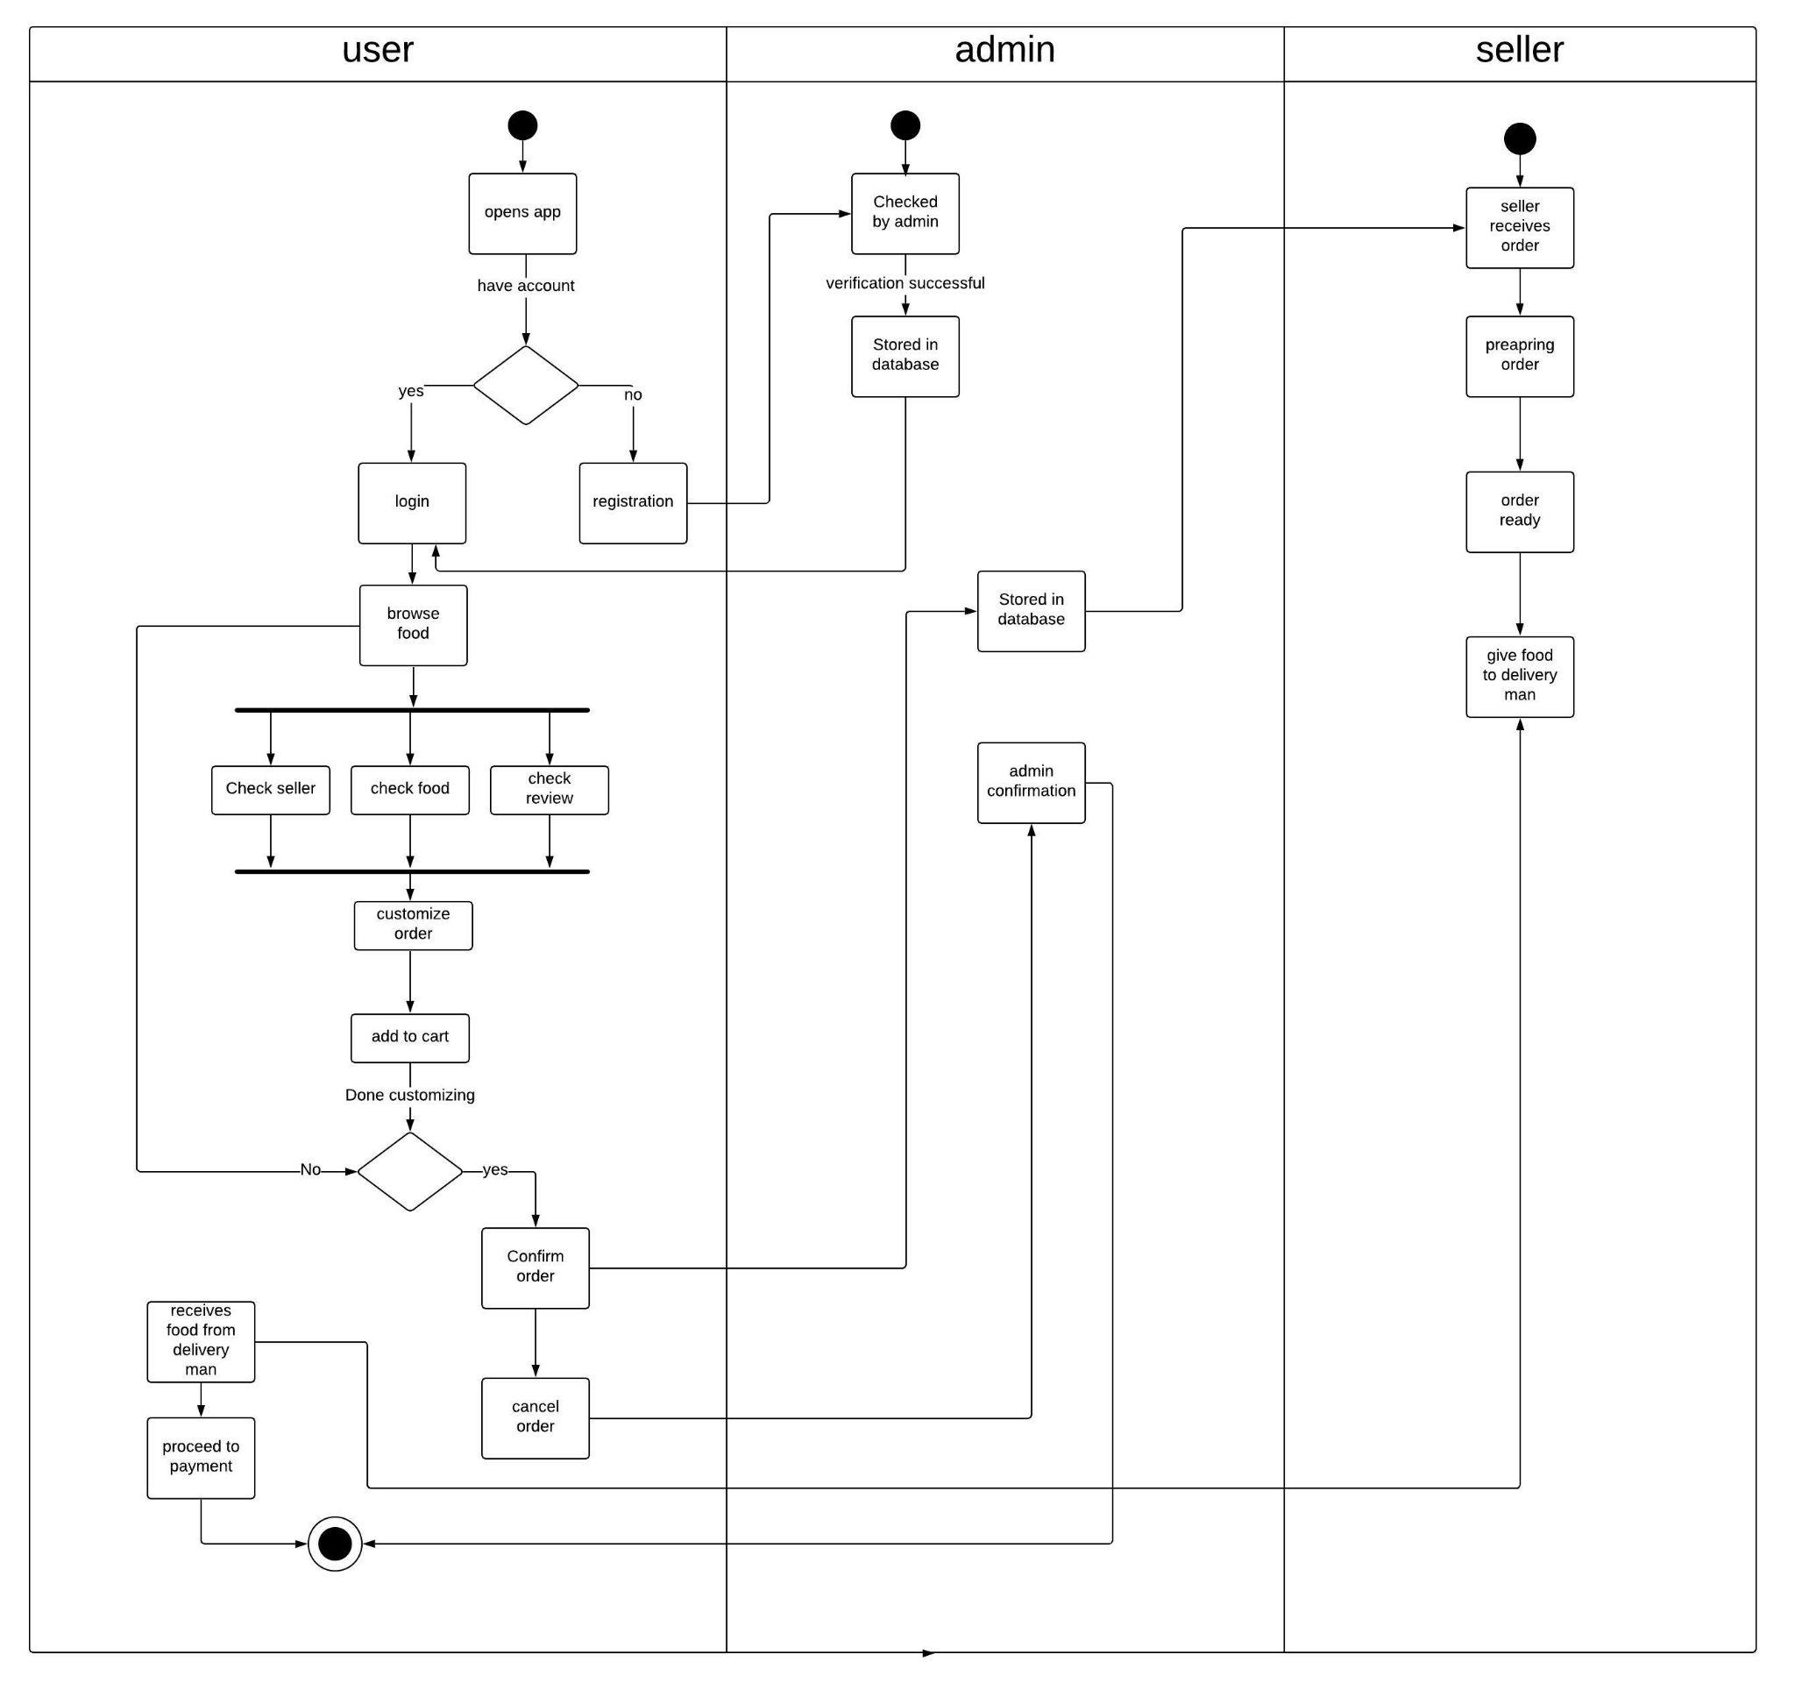
Activity Diagram: Order place and manage
https://lucid.app/lucidchart/invitations/accept/inv_81aa4120-9264-407c-8124-715897139f4f

Slide 8
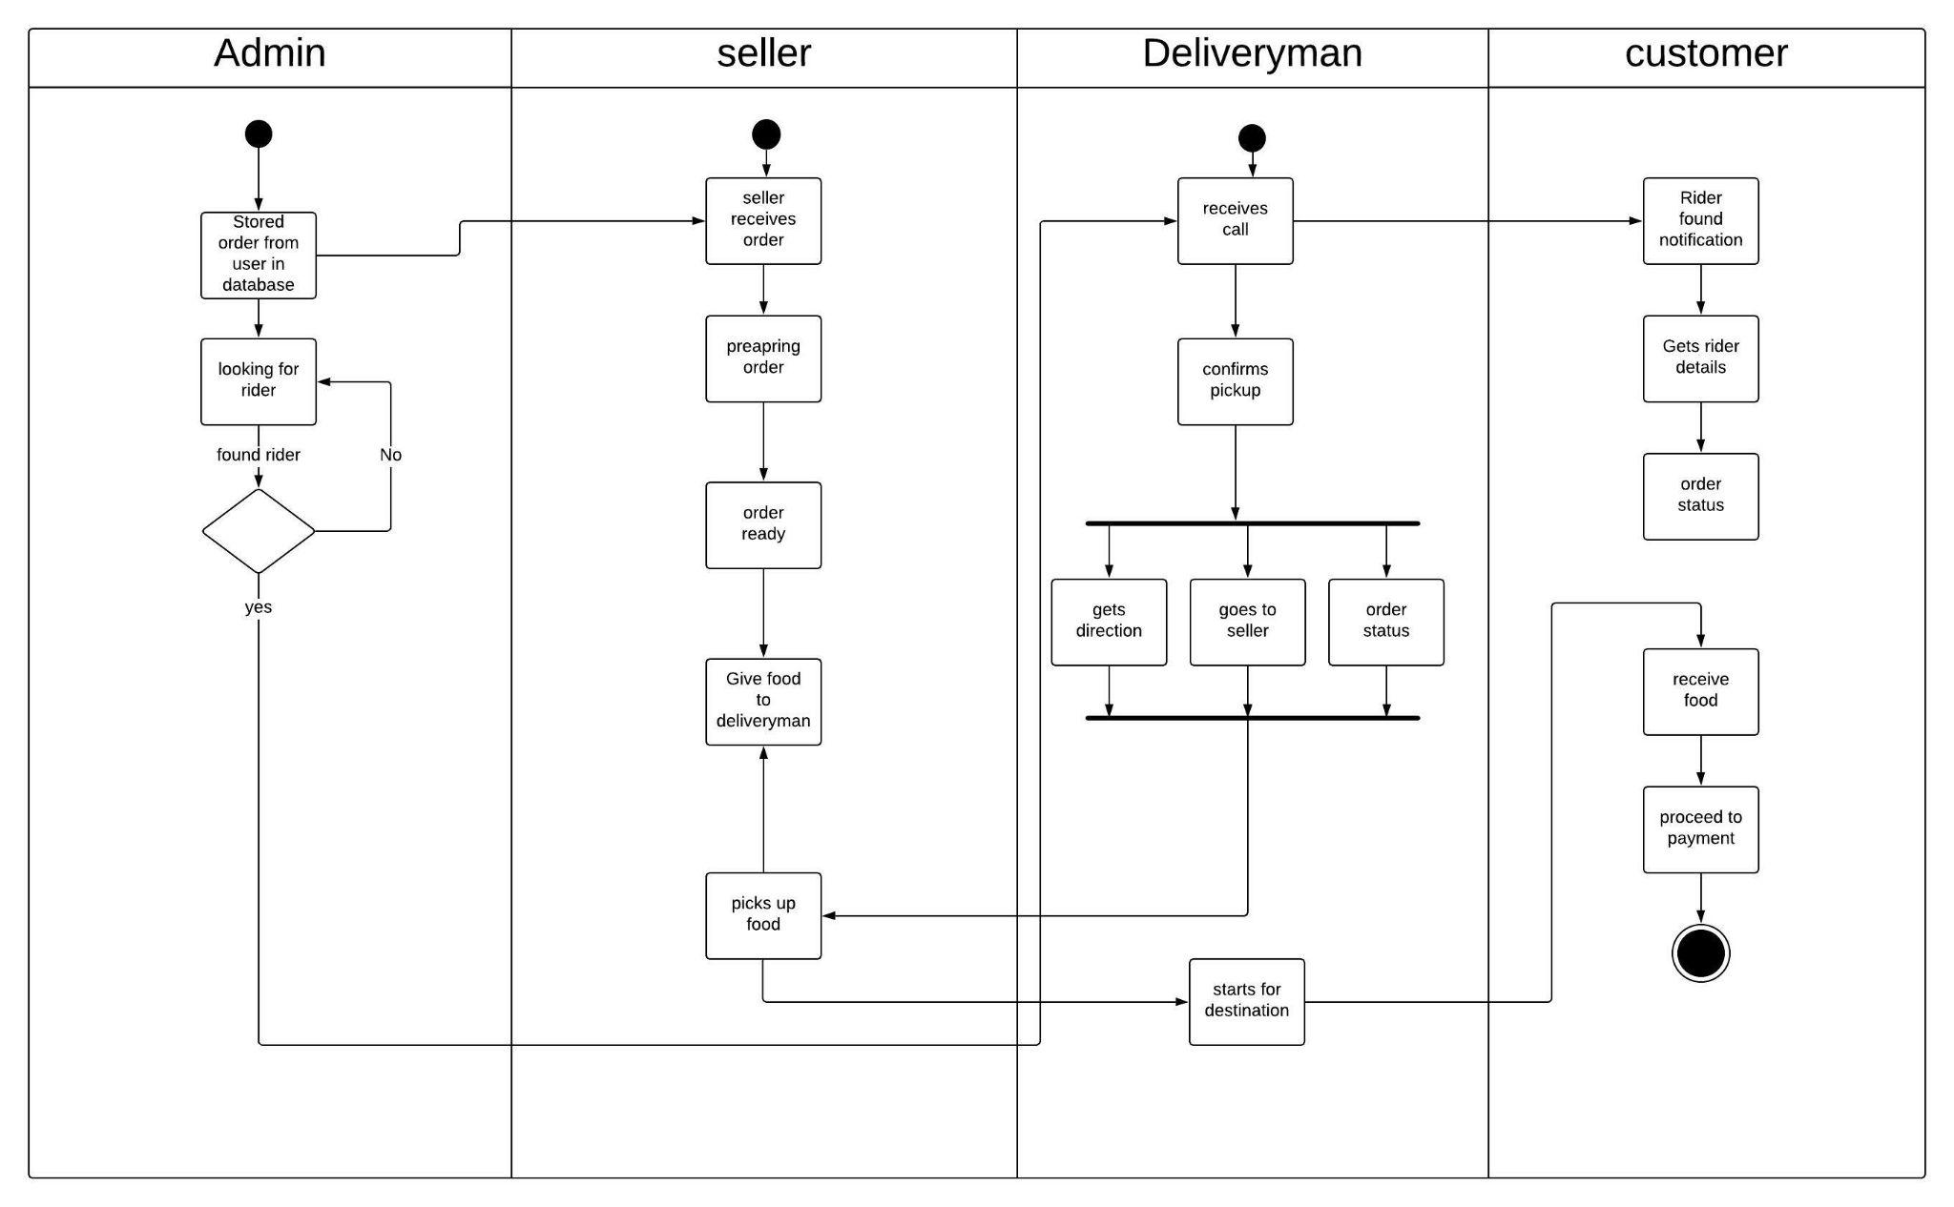
Activity Diagram: Delivery process
https://lucid.app/lucidchart/invitations/accept/inv_81aa4120-9264-407c-8124-715897139f4f

Slide 9
State Machine Diagram:
• This diagram represents the custom order by viewing & selecting items categorically and the payment process of the Custom Bakery Order System.
•After login, when they search for bakery items they will be able to view all items.
•After selecting bakery categories, there is a new state named customize bakery bakery item where they can easily place custom orders according to their suitable preferences.
•Customers can add items to the cart and if they want more items they can go back.
•After completing order, the customer can request for payment method and get a bill.
• Log out from the system.

Slide 10
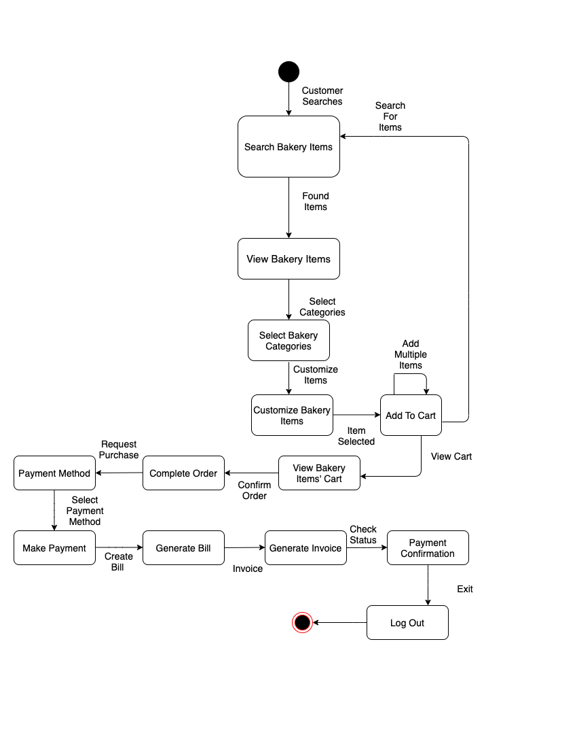
State Machine Diagram
https://drive.google.com/file/d/14cs-VEWH6ttRlO405tUGHFBT7lI-608z/view?usp=sharing

Slide 11
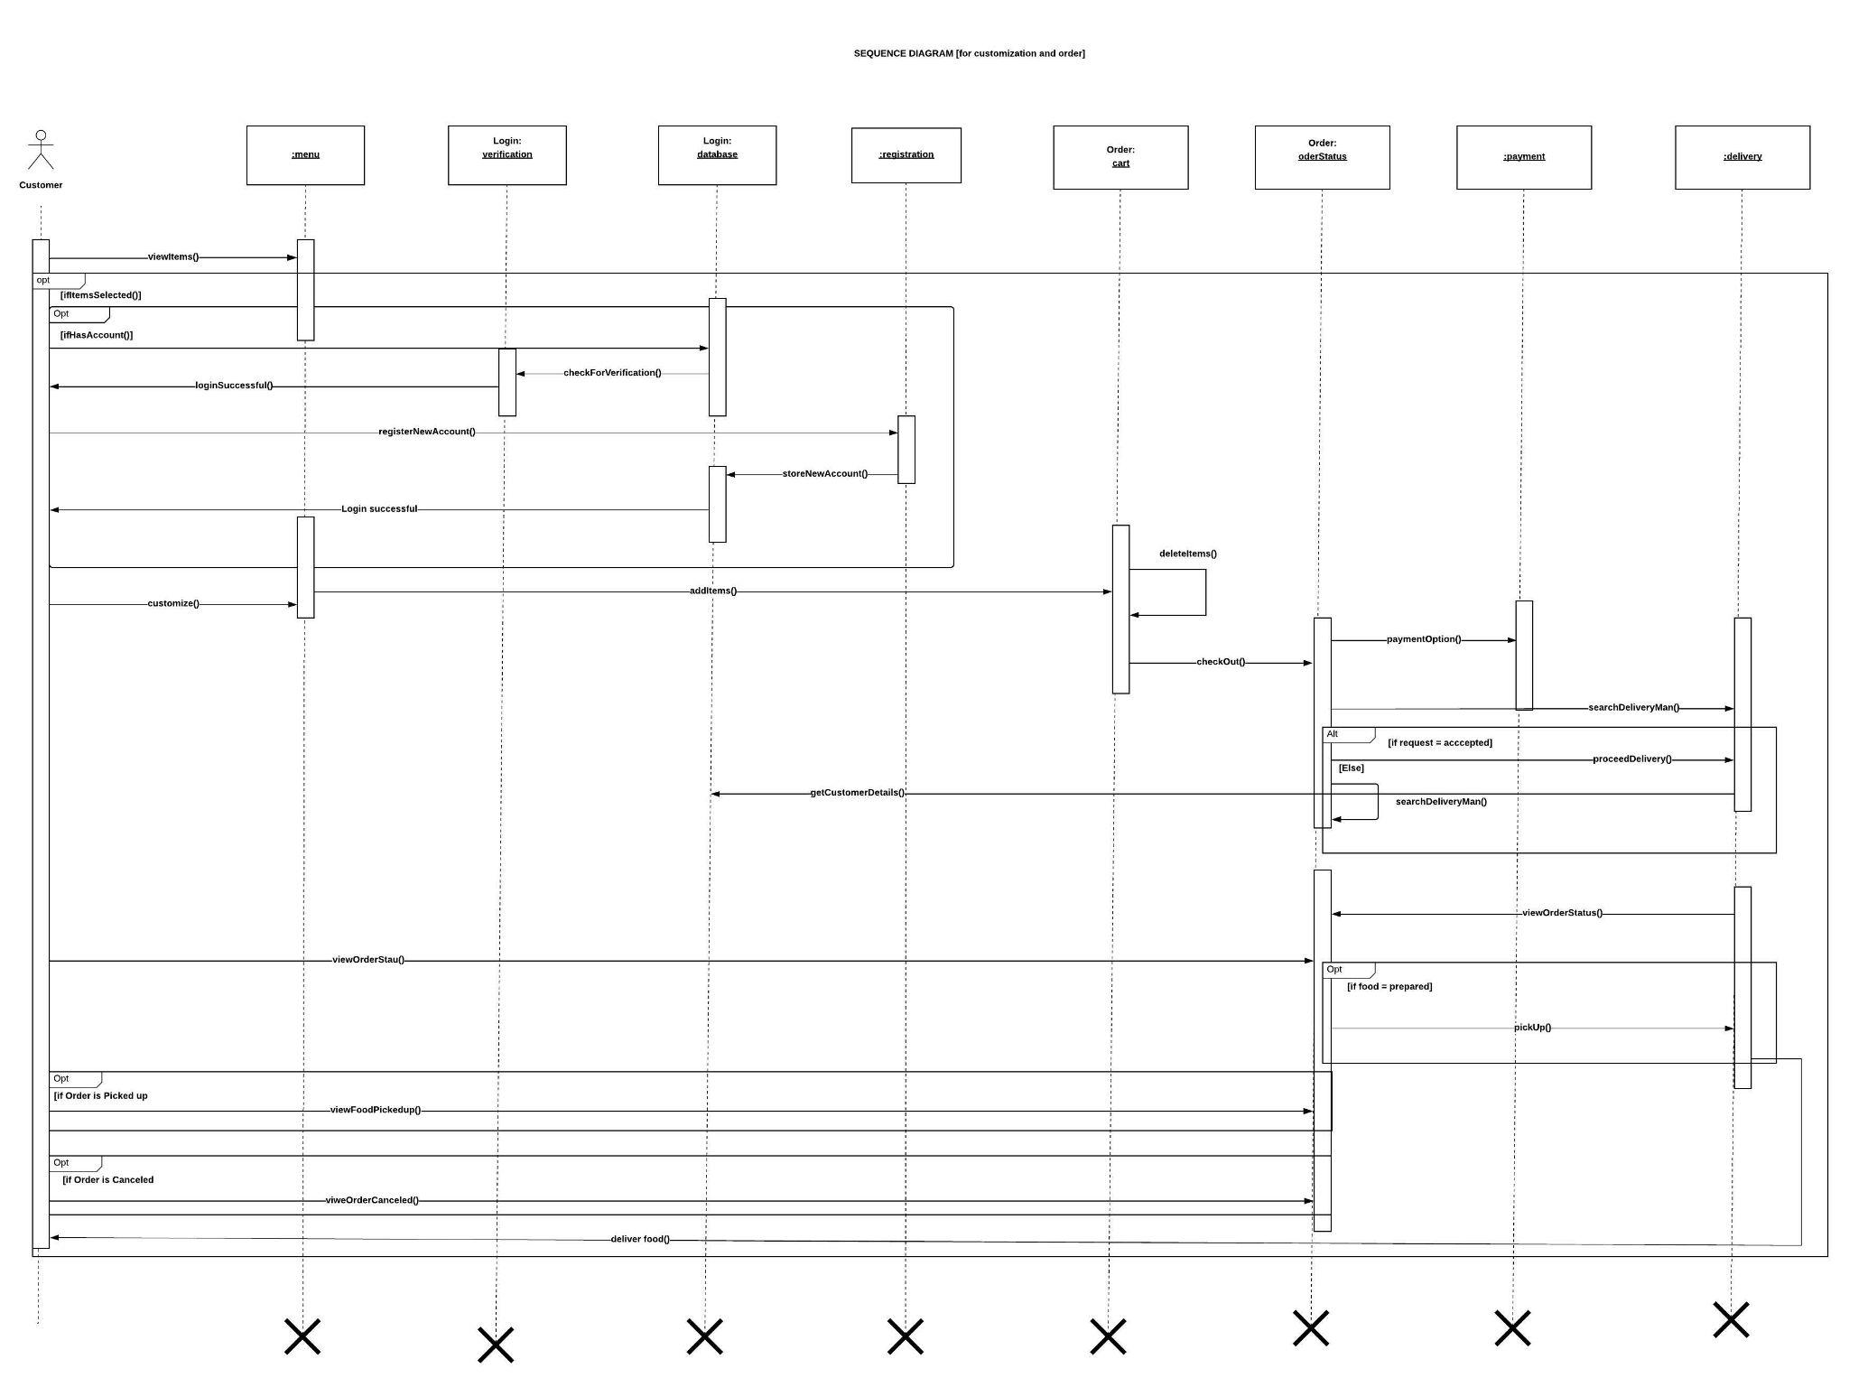
Sequence Diagram: Login, order place and manage
https://lucid.app/lucidchart/invitations/accept/inv_c9c378fd-4617-4075-a2eb-a692bfd216b2?viewport_loc=-1603%2C193%2C2866%2C1223%2CwjgjeWBNXUqMe

Slide 12
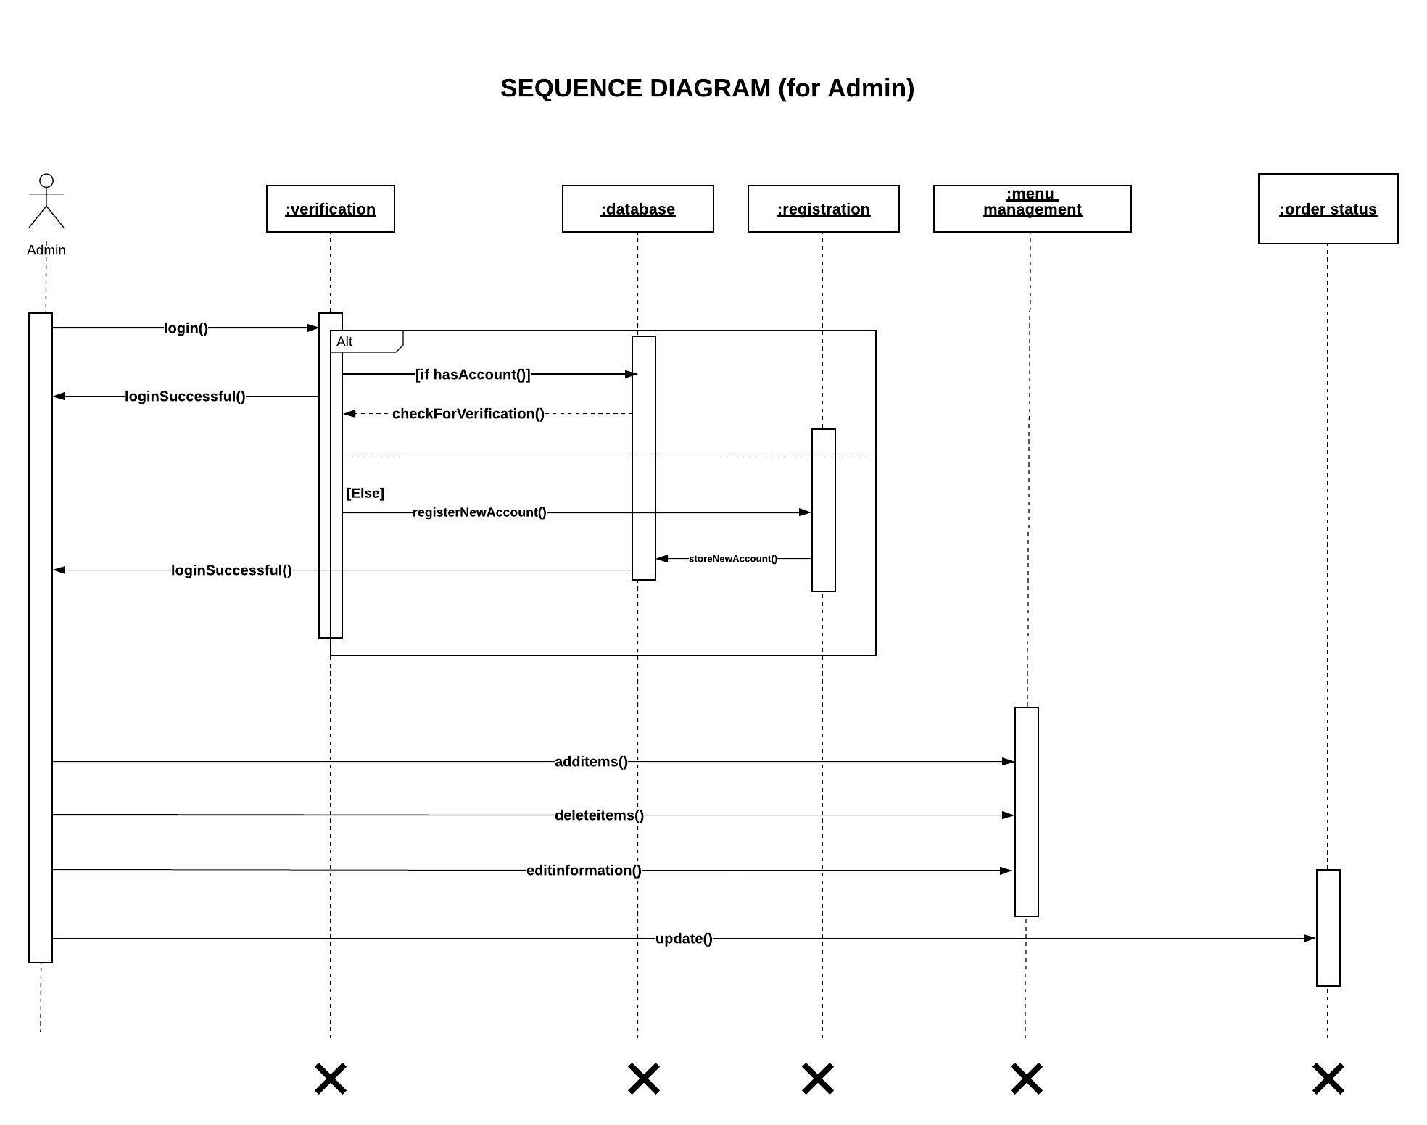
Sequence Diagram: Admin managing the system
https://lucid.app/lucidchart/invitations/accept/inv_28497c75-1dbf-4bda-aedb-85f9192289fb

Slide 13
DFD:
• This diagram represents process of the Custom Bakery Order System and how the data flow is distributed to different external agents(customer, admin, baker, delivery man) and data stores.
•All types of users will login/ register in order to use the application and provide necessary information.
•After login confirmation the customer will be able to view and select items. They can place custom order & complete payment. They can also give feedbacks to the system.
•The bakers can edit items categorically , price info, order status.They can only sell bakery items when they get selling permit from the process. They can receive feedbacks from the process.
•The system will request for delivery man to confirm delivery by providing order details. The delivery man will be able to retrieve payment and receive feedbacks.
• The admin will check and verify important information, perform the administrative functions and provide information to the system.
• Data can be retrieved from the data stores and necessary data can be stored and updated in the data stores.

Slide 14
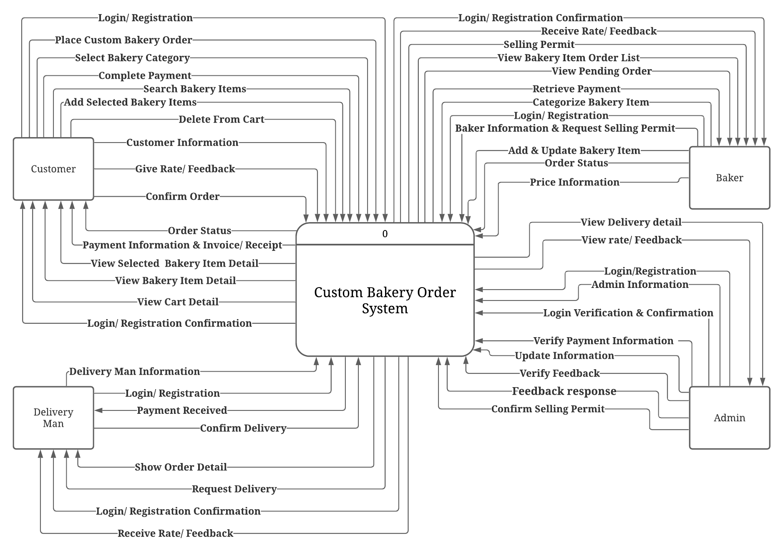
DFD Diagram
Level 0
https://lucid.app/lucidchart/invitations/accept/inv_505aec5a-64bc-4755-a4f7-ba1de0adfe8d

Slide 15
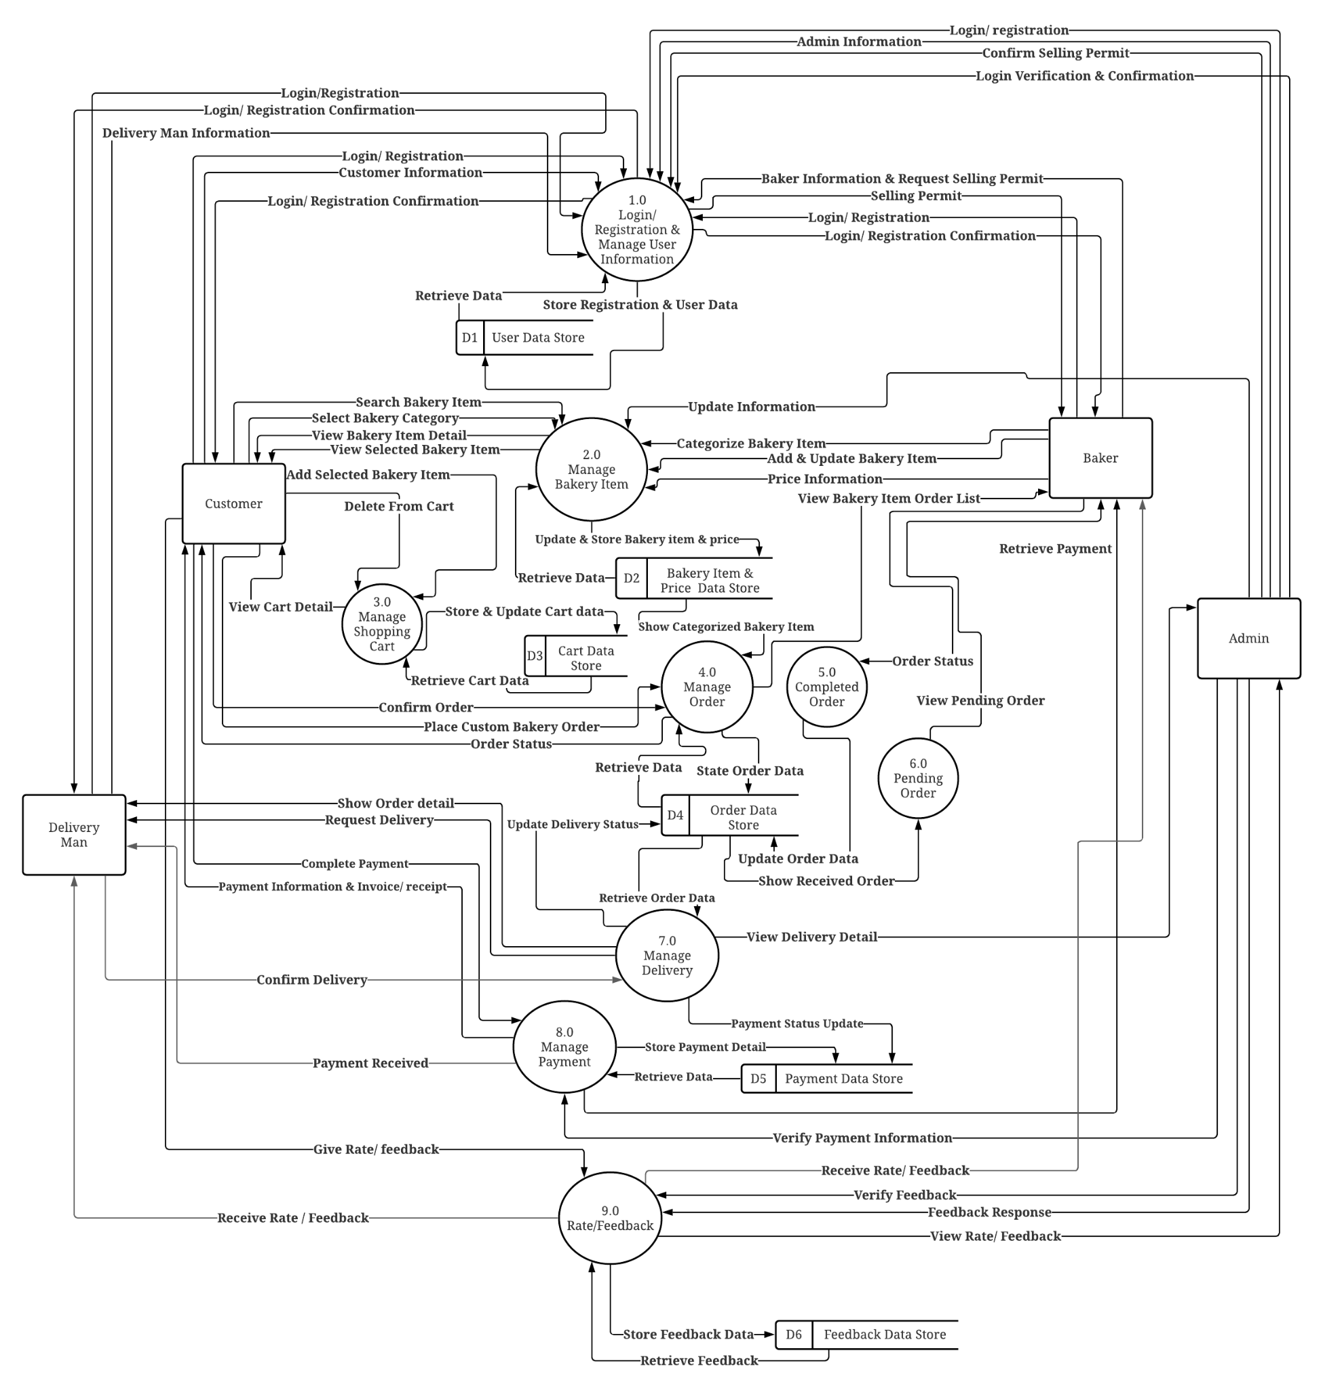
DFD Diagram
Level 1
https://lucid.app/lucidchart/invitations/accept/inv_36f7e1cd-0c73-452b-b526-8d9e9d5bc903?viewport_loc=1%2C57%2C2731%2C1323%2C0_0

Slide 16
Summary and Conclusion
“Bake & Bake” is an online bakery shop platform where anyone can start to sell their baked goods.
The online platform will provide users to customize their different types of bakery items like cake, cookies, bread etc by flavors, sizes, toppings and even by ingredients so that all kinds of people can enjoy their favorite home bakers in their own way to get it delivered to their homes.
Moreover, many talented home bakers can get jobs and recognitions for their amazing baking talent.
“Bake & Bake” prides itself in the exceptional customer service for being able to make delicious custom made-to-order different types of bakery items for all kinds of events and gatherings.
In conclusion, we always need to pay attention to our customers’ needs and their feedbacks in order to make the platform more sustainable and successful.

